Slide 1
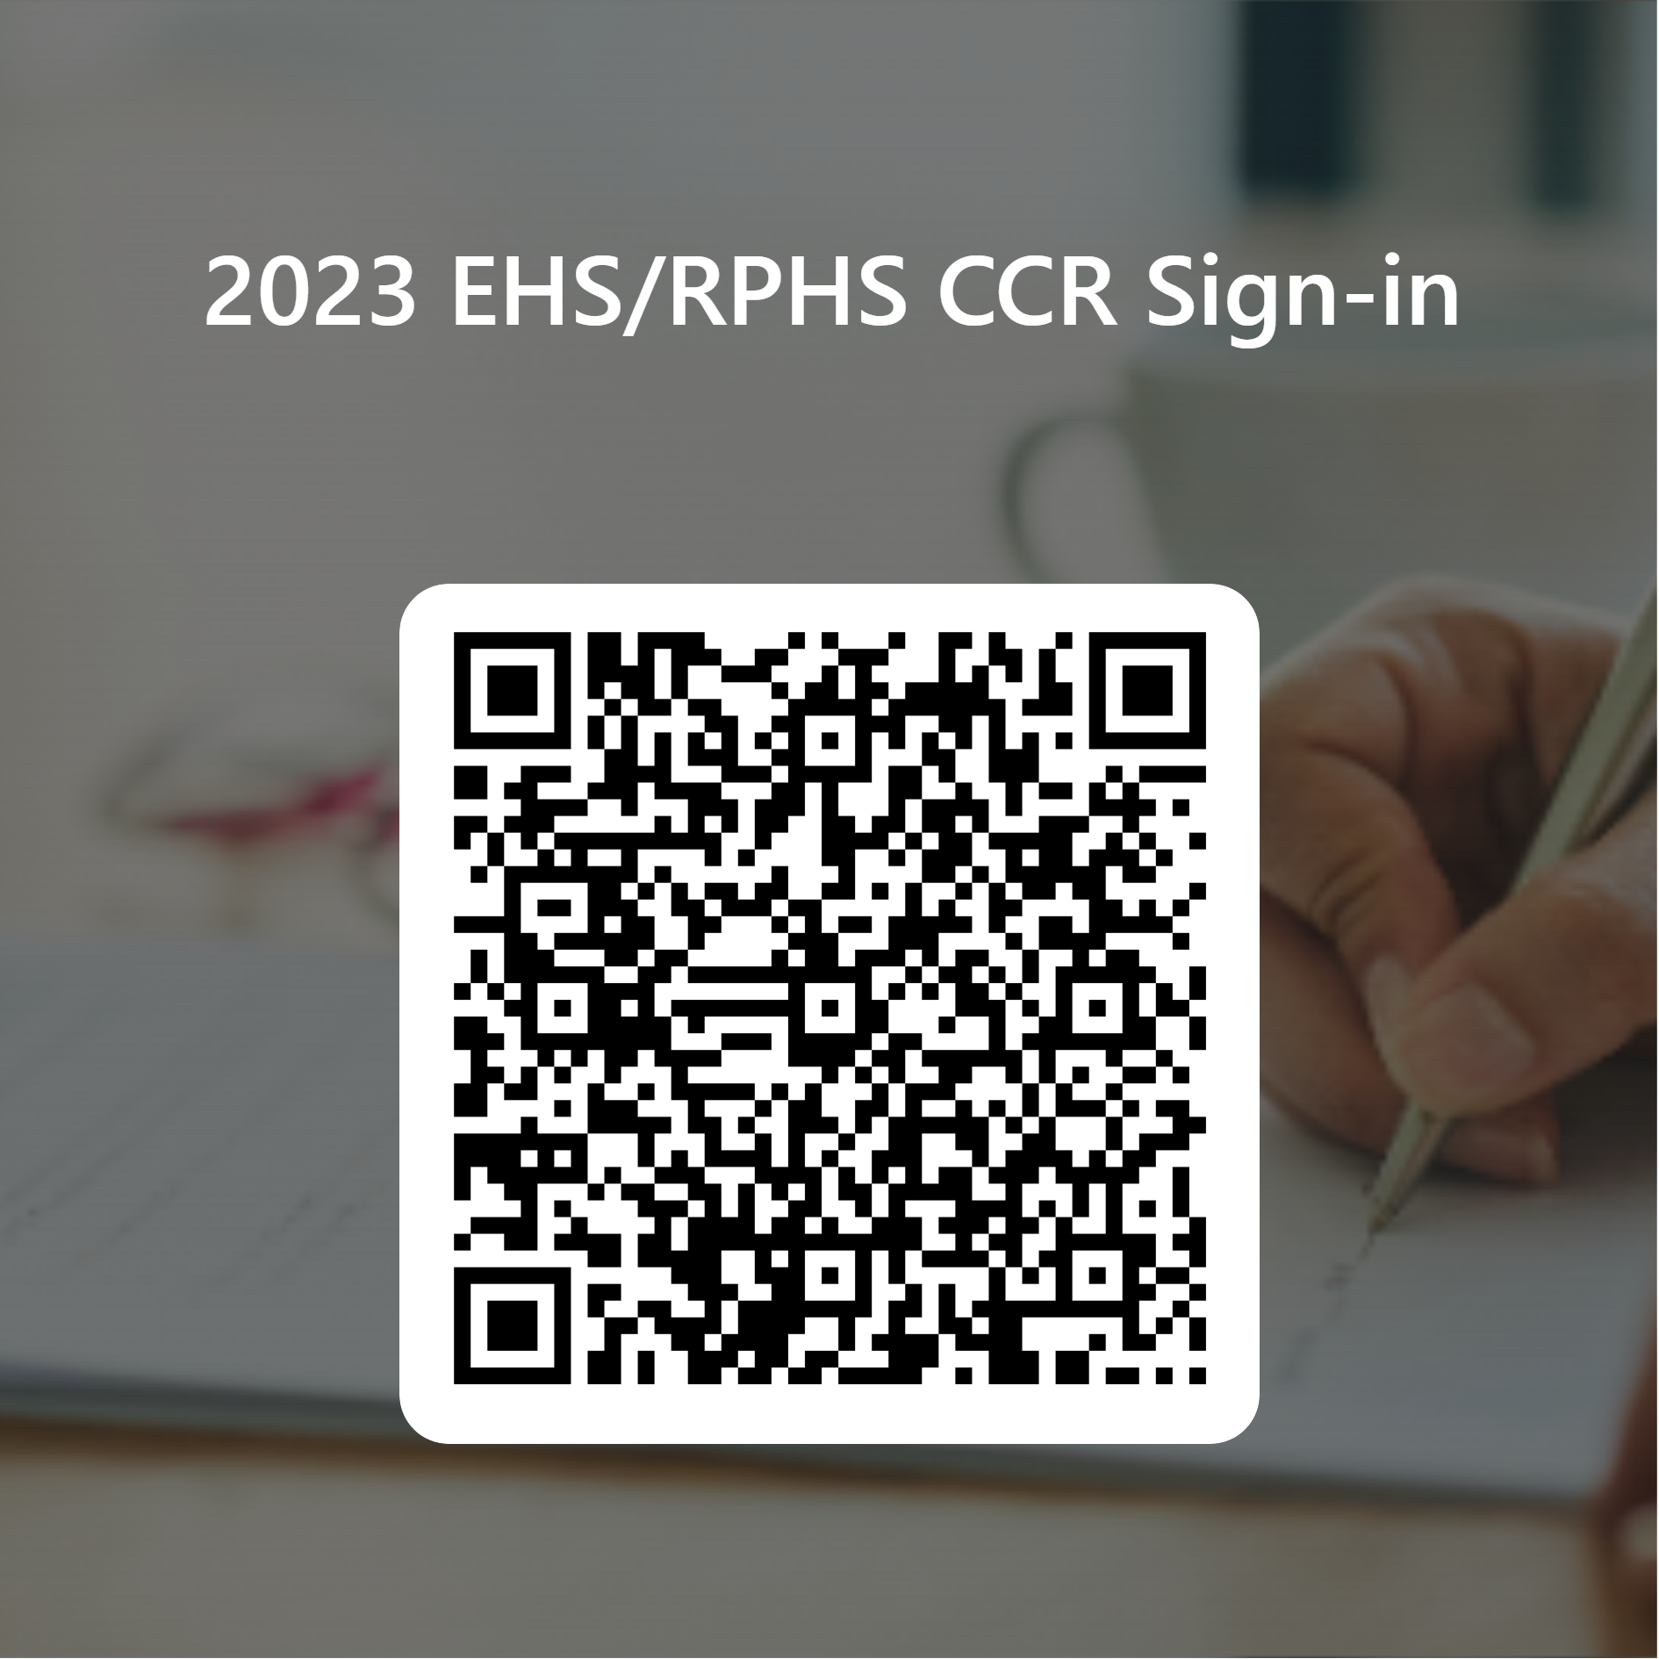
Must Scan & Sign-in
For SAT, ACT, & College Application Fee waiver & CCR T-shirt
https://forms.office.com/r/m6xSZKUEmG

Slide 2
Elkins & RidgePoint High School 12th Grade College Application Guide & SchooLinks info.
August 2023

Slide 3
Who am I
What do I do
Where am I located
When can you see me?

Slide 4
Lead Counselor, Dina Powis
Last Names Sn - Z
Dina.Powis@fortbendisd.com
281-634-2613
Counselor, Kathleen Fey
Last Names A - Cha
Kathleen.Fey@fortbendisd.com
281-634-2607
Counselor, Richerica Wolf
Last Names Chb - G
Richerica.Wolf@fortbendisd.com
281-634-9843
Counselor, Ivy James
Last Names H - Le
Ivy.BowenJames@fortbendisd.com
Counselor, Elisha Carter
Last Names Li - Pao
Elisha.Carter@fortbendisd.com
281-634-2612
Counselor, Braiyon Sands
Last Name Pap - Sm
Braiyon.Sands@fortbendisd.com
281-634-2612
Counselor Clerk, Andrea Adams
Andrea.Adams@fortbendisd.com
281-634-3070
Counselor Clerk, Mary Sullivan
MaryE.Sullivan@fortbendisd.com
281-634-6257
Your EHS Counseling Team
ABOUT COUNSELING
Professional School Counselors are available at Lawrence Elkins High School to provide a Comprehensive Developmental Guidance Program and services for all students in the areas of: Guidance Curriculum - In an effort to help students develop competence in essential life skills
Responsive Services - Provide intervention for immediate personal/social/emotional concerns
Individual Planning - Provide guidance to help students plan, monitor, and manage their personal, educational and career goals, and facilitate transition activities for post-secondary education and/or training
System Support - Support campus staff, parents, and community to promote the educational, career, personal, and social development of students, as well as the Developmental Guidance Program
EHS High School Code (CEEB) 446782 EHS SAT TEST CENTER CODE 44-845 EHS ACT TEST CENTER CODE 156760

Slide 5
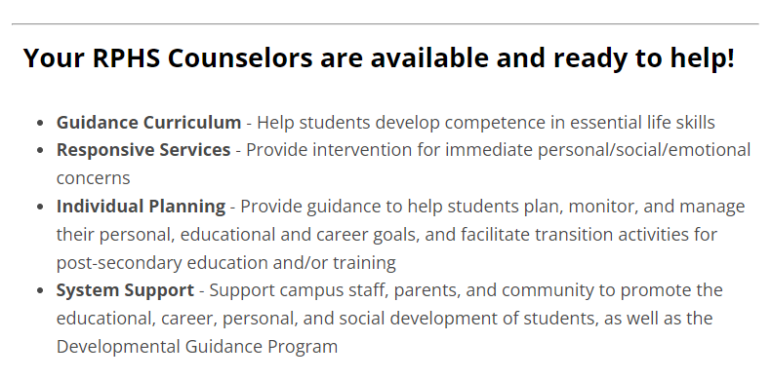
Your RPHS Counseling Team
Kaylynn Will, Lead Counselor (last names U-Z)
Melanie Blain-Tannous (last names A-C)
Brandi Goodly (last names D-He)
Tim Hemlin (last names Re-T)
Jill Tschetter (last names Martin-Ra)
Angela White (last names Hi-Marshall)
Andrea Garcia, Counselor Clerk

Slide 6
Important Changes for 2023-2024
in the world of FBISD CCR:
Shared CCMR Advisor Shared Model
SchooLinks replacing Naviance
Graduation requirements changes: FAFSA, & CPR
CCMR District-Wide Events :Pathways to Success: College, Career, and Military Readiness Event Series

Slide 7
Important CCMR Programming Dates :
August 29th & 31th : 12th Grade College Application & SchooLinks Workshop ( 4th Period) & 5th Period ( UT, PVAMU, U of H, Rice University will be here to assist 12th graders with their apps)
September 6: Virtual Combined CCR & Counseling Department Elkins & Ridgepoint 11th (6pm) & 12th (7pm) grade parent meet. Look out for email invite.
7-8pm: Fort Bend ISD-Elkins HS and
HS Senior (12th Grade) Parent Meeting
https://esc4.zoom.us/j/97991209977
October 17 (Elkins) 19 (Ridge Point): CPR, Peace Officer, & FAFSA Graduation requirements workshop ( 3rd & 4th periods)
October 24 ( Elkins) 25 (Ridge Point): ASVAB Exam offer on campus ( 10th-12th grades, 2nd – 5th periods)
This Photo by Unknown Author is licensed under CC BY-SA-NC

Slide 8
FBISD District-wide CCMR Events

Slide 9
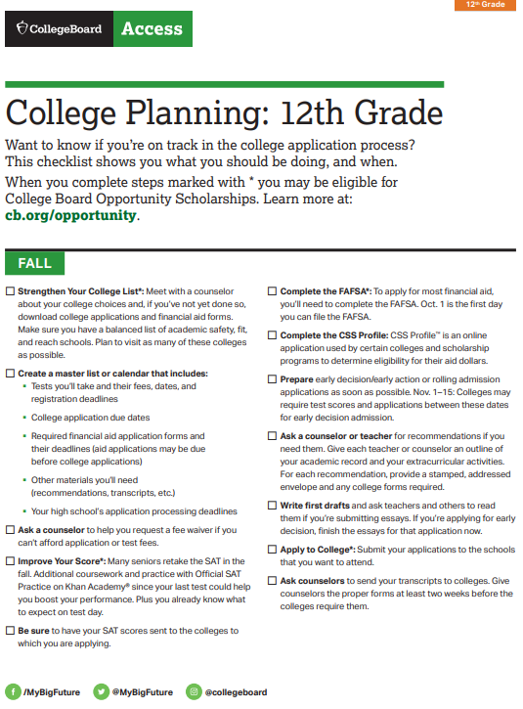
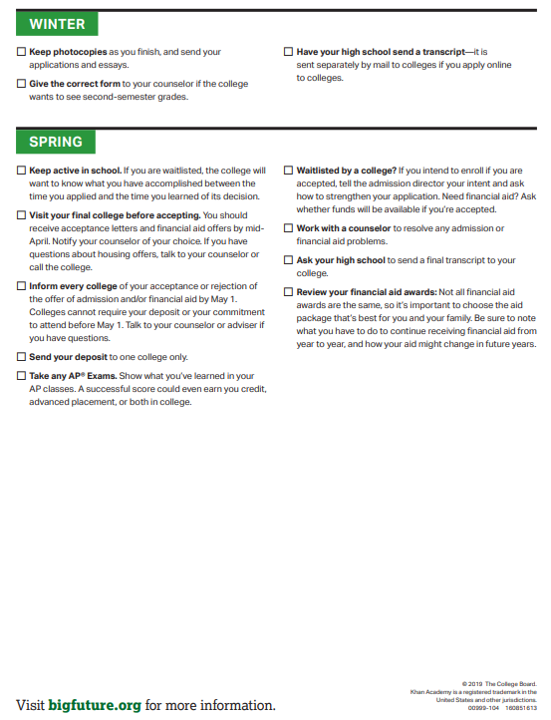
12th Grade CCMR
To Do List by the month

Slide 10
How to Apply!

Slide 11
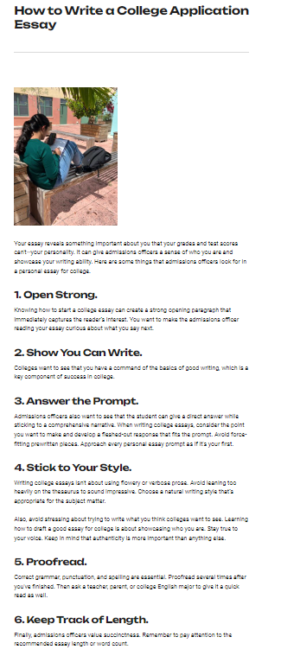
What to focus on until
September 15th?
12th grader - Write and rewrite your essays to represent you in rooms that your feet may never touch!
Have your 12th grader create an all-inclusive resume with all in-school and outside school, including sports, volunteer work, and work in their place of worship resume. No more than 2 pages. ( For scholarships and college apps, not letter of recommendation request)

Slide 12
Types of College App Deadlines
Rolling, Priority, & Regular
Early Action vs Early Decision
Rolling - Applications roll in & Decisions roll out
Priority - Equals $$ Scholarship consideration
Early Decision (binding)
Early Action (non-binding)
Restrictive Early Action - Students can only
apply to one school through early action, and all other colleges must be applied to through
Regular Decision or ED

Slide 13
Auto Admit does NOT mean You Got your College Major

Slide 14
Types of College Apps Systems
Common App
ApplyTexas
Commonapp.org
Many ApplyTexas colleges are also in CommonApp
Consider completing all of your colleges apps. via www.Commonapp.org
ApplyTexas.org
Public colleges in Texas and a few private colleges

Slide 15
Types of College Apps Systems
Coalition App
Direct to Institution
https://www.coalitionforcollegeaccess.org/
Many CommonApp colleges are also in the Coalition
150 Colleges use the
Coalition Application
ApplyTexas.org
Public colleges in Texas and a few private colleges

Slide 16
Types of Colleges – Ivy, Private, Public
Open Admissions, Technical, etc
Ivies – Public & Private, Selective Colleges

Slide 17
Important To Do’s From your Counselors
Graduation Plan
Classes taken outside of Ridge Point December Completion Due Date
Know and stay on top
TTU classes
UT classes
TxVSN
classes

Slide 18
Tests, Tests, Tests – Do I need to send or NOT??
ACT vs SAT - Try to complete both or either by October to meet December 1st app. Deadlines.
SAT is NOT your only option
Many students do very well on the ACT
TSI – Offered 3 times this year
Optional
Blind
Look for the average test score
of those accepted and decide if you will
send
* Rule of thumb:
If your score is lower than the
average admitted test scores for the
college that you are interested in
– Do NOT send test score
Use the gift of test optional

Slide 19
Email Etiquette
Who are you?
What school Do you attend?
What is your student ID#
Greetings
Contact info.
Communicate how you want to be communicated to

Slide 20
SchooLinks: All Things College & Career Ready
SchooLinks replaced Naviance
SchooLinks Overview
What is SchoolLinks?
New college and career readiness platform that allows students to explore, plan and realize their post secondary goals. Seniors will request transcripts for all college applications, and complete 5 more “senior tasks” in SchoolLinks
All Seniors must complete the initial onboarding process ASAP
To access SchoolLinks, scan here -→

Slide 21
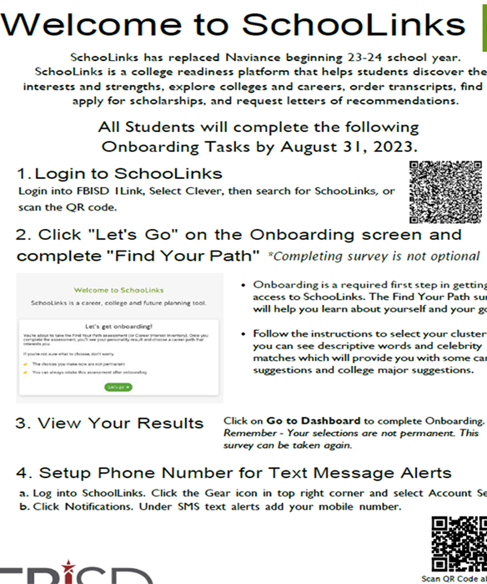

Slide 22
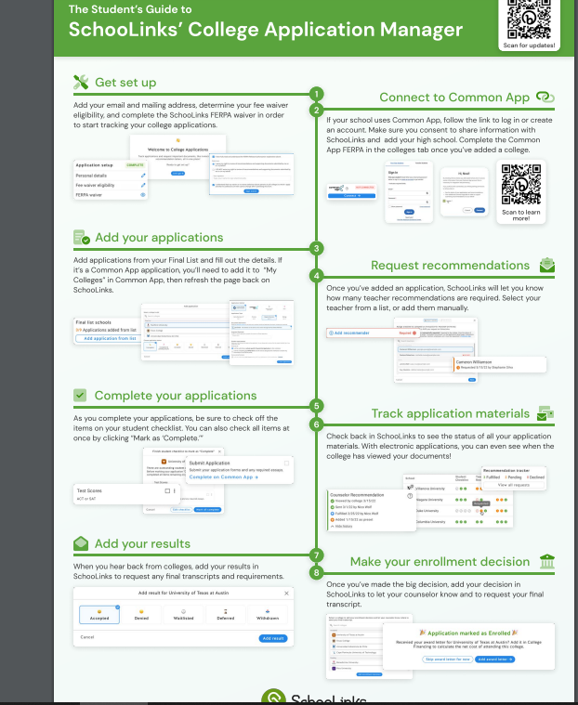
College Application Manager
College Application Manager (order transcripts & connect application to CommonApp & SchooLinks)
What is College Application Manager?
The SchooLinks College Application Manager allows you to:
Track the progress and requirements for your college applications.
Organize of all the application materials for the colleges where you're applying.
Request your application materials including transcripts, letters of recommendation, etc. to be sent to the desired institution.
College Application Manager serves as an easy way to keep track of all the application steps and materials you need to submit to colleges and when you need to submit them, but it is not an application portal. You will need to submit applications using the methods offered by the colleges where you're applying.

Slide 23
Ordering Transcripts in College Application Manager
College Application Manager
(Order transcripts here & connect application to CommonApp & SchooLinks)
* Important Note*
If you are happy with your current class rank and it qualifies you for auto admit into your choice schools, request that your transcripts be sent to your colleges no later than Monday, September 11th

Slide 24
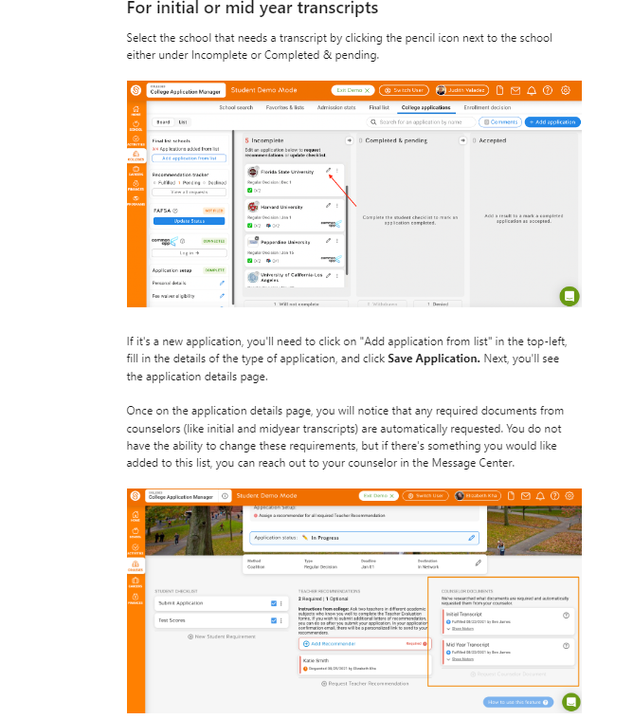
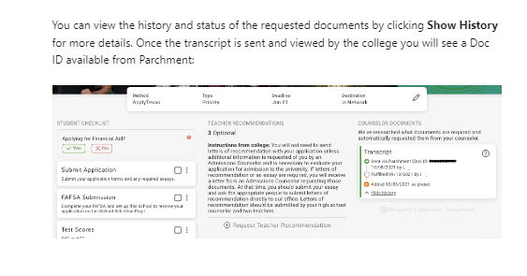
Letters of Recommendation - Request
Ask teacher and counselor in person
Submit letter of rec brag sheet to each recommender
Submit request in SchooLinks
Step 1
Step 2
Step 3

Slide 25
2 Excused Absence College visits this year & CCR Has 2 College Fieldtrips TBD
A student shall be excused for up to two (2) days during the student’s junior year and up to two (2) days during the student’s senior year to visit an accredited institution of higher education. A student shall be required to submit verification of such visit(s) by providing:
A letter from the university/college verifying the date(s) and purpose of the visit in order to be counted present for attendance accounting purposes.
If a university/college verification letter is not submitted with in two (2) school days after the visit, the absence(s) will be considered unexcused.

Slide 26
FAFSA * Other Graduation Requirements: Oct 17 (Elkins) 19 (Ridge Point) Assembly
District FAFSA Night- December 6, 2023 @ 6:00 pm –Virtual Event- more information is forthcoming!
State of Texas law that all graduating Seniors MUST complete the FAFSA/TASFA/Opt-Out form
Start by creating a FSAID @ https://studentaid.gov/fsa-id/create-account/launch
Submit for verification to SchooLinks – Tutorial Forthcoming
Added to Official Transcript by the Registrar
*By completing an opt-out form, you are stating for graduation ONLY you are choosing NOT to complete a FAFSA/TASFA application. Student can STILL complete the FAFSA application.
FAFSA/TASFA Priority deadline has not been determined because the FAFSA application doesn’t open until December 1st this year.

Slide 27
Finding Scholarships in SchooLinks

Slide 28
Thank you for your attention!
The Elkins & Ridge Point HS’s CCR & Counseling team
wishes you the best as you pursue your post-high school goals!

Slide 29
FORT BEND ISD
16431 Lexington Blvd.
Sugar Land, TX 77479
281-634-1000
www.fortbendisd.com

